Slide 1
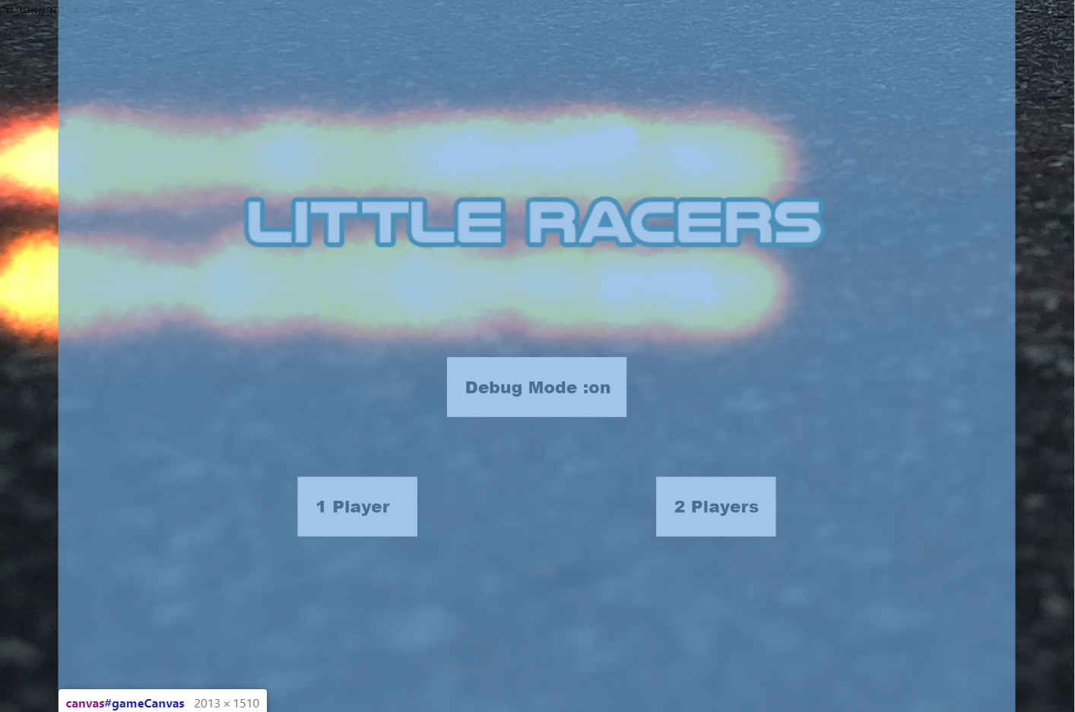
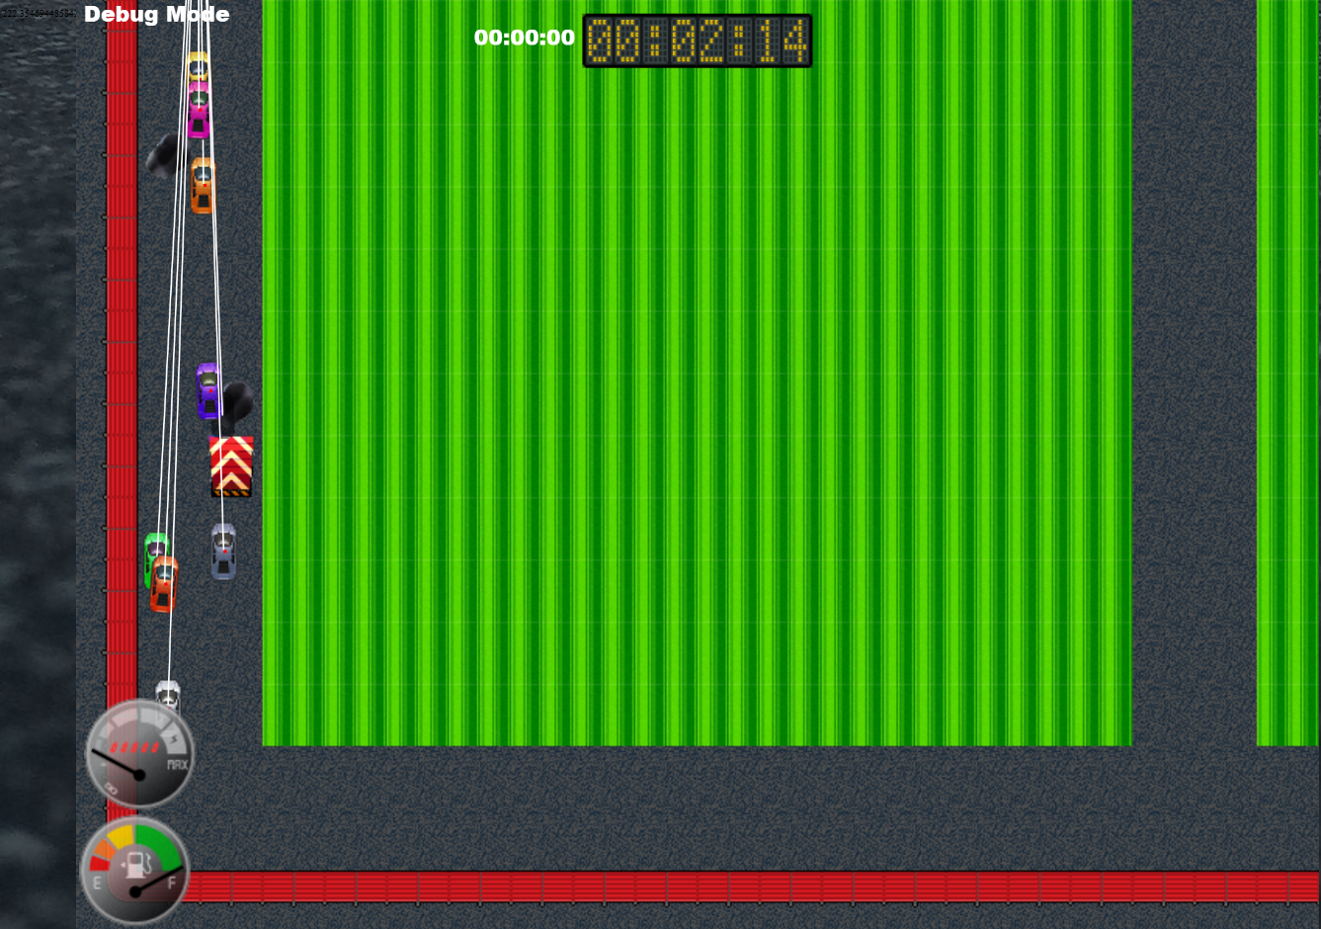
Little Racers
Pitch Date: June 22 , 2019 Week 5: 7/27/2019
Release Date: September 15, 2019 7 weeks to go!
Team Lead: Vince McKeown
17 contributors

Slide 2
Updates to Code (over 40 commits!)
Mike LeSauvage
Added corner arena boundary walls
Comments to explain shields and health
Consolidated a bunch of code
Implemented clock font, made corrections to upgrade screen
Fixed a lot of things!
Simon
Oil causes car to slip
Fixed damaged particle merge

Slide 3
Updates to Code
Baris Koklu
AI for car braking on turns
Christer “McFunky Pants” Kaitila
Fire Effects enabled in title screen
Anthony Free
Car catches on fire! Added particle fire effects.
H Trayford
Title Screen loop for Fire Animation.
Changed SmokeFX parameters
Varying AI code for waypoint and slow down modified

Slide 4
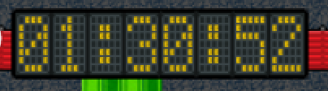
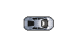

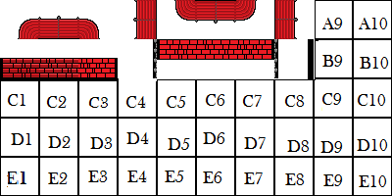
Updates to Art
Jeff Hanlon
ContrerasJ

Slide 5
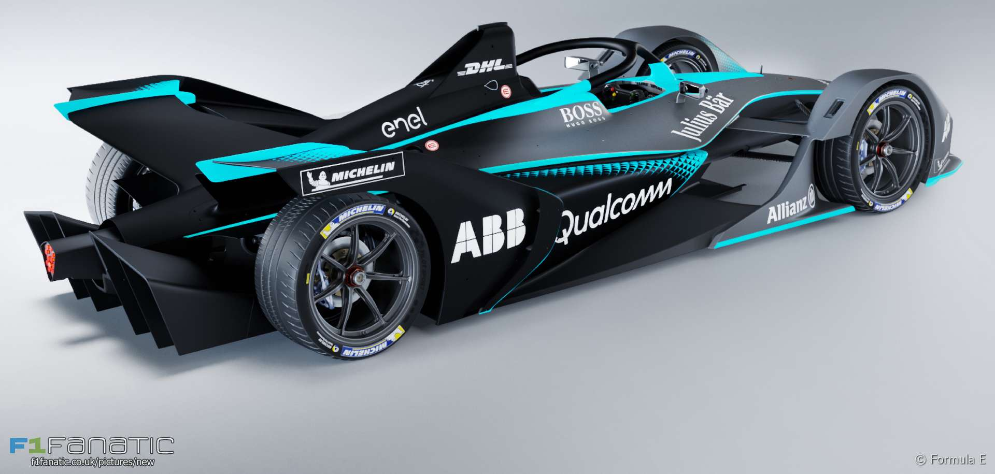
Demo
Cutover to Game

